Slide 1
AI RPG Design
Marc Doctor

Slide 2
TYPES OF AI - COMMON TERMS
Agent
Algorithmic Agent
NPC
Cheating AI

Slide 3
TYPES OF AI - SPECIALIZED & DIFFERENTIATIONS

Slide 4
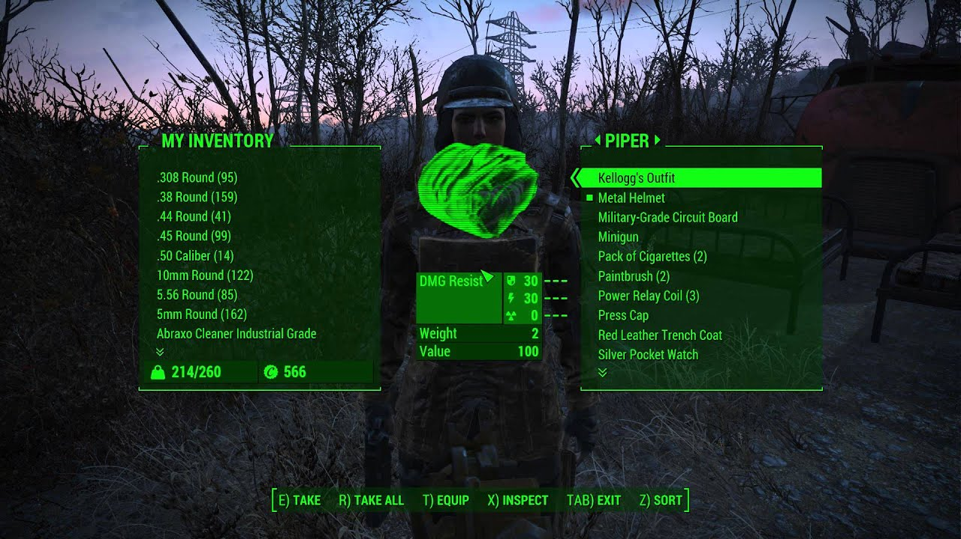
TYPES OF NPCs - MULE
2 Types
Example:
Companions

Slide 5
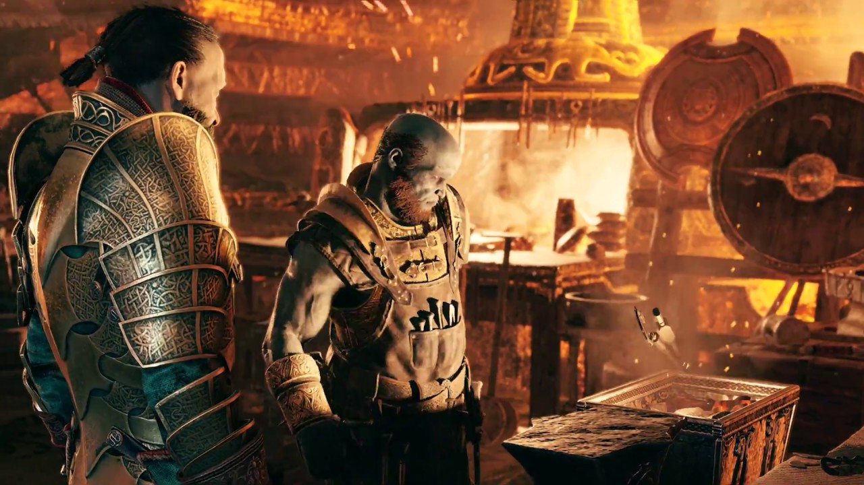
TYPES OF NPCs - helpers: SERVICERS VS VENDORS
The blacksmiths from GOW do both

Slide 6
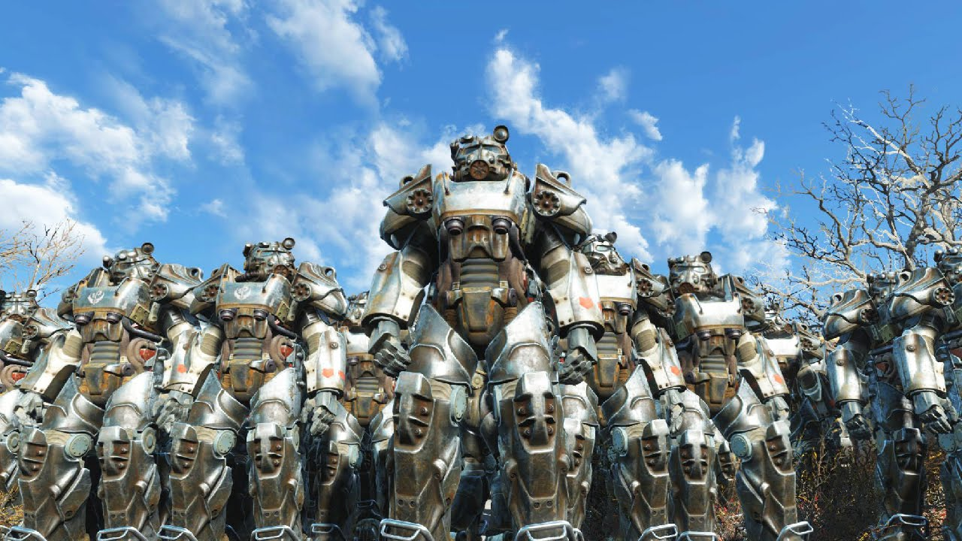
TYPES OF NPCs - friends: SIDEKICK vs ALLY vs COMPANION
Sidekick: single, help
Ally: groups, combat
Companion: orders
A bunch of allies in Fallout

Slide 7
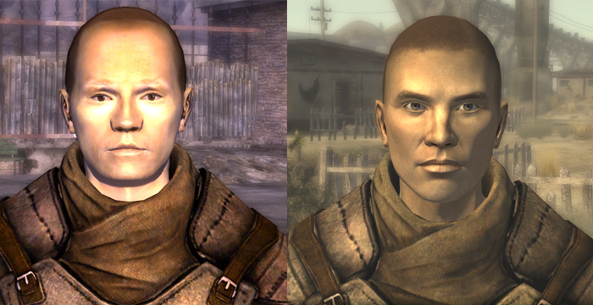
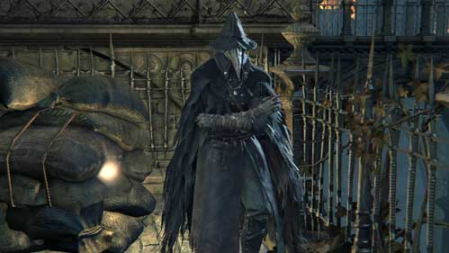
THEY HAVE 4 COMMONALITIES
1) QuestGivers: 2 types
2) Perceived: Location + actions + looks
VS

Slide 8
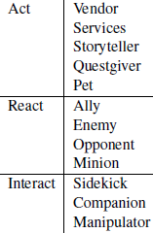
THEY HAVE 4 COMMONALITIES
3) Act React Interact
4) Embedded vs Emergent

Slide 9
EXERCISE part 1:
Identify the main AI types in your game
TAKE INTO ACCOUNT
Act React Interact
How will you make sure they are perceived ?
Extra (For groups with Quests)
QuestGivers type ?

Slide 10
FUNCTIONS OF NPCs - DESIGN PATTERNS

Slide 11
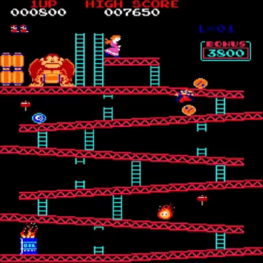
ADVERSARY: enemy vs opponent
1) Enemy: your average skeleton (that’s it)
2) Opponent:
Slow down players progression
Develop new strategies
Own Goals
Can be: Manipulator, Villain...

Slide 12
ROLE MODEL
Serves as example to the player
Shows him how to perform a task
Tests the player’s ability to learn
“Practical tutorial”

Slide 13
EDITABLE
Usually players change their stats
Editable AI can be altered too
Example: Altering a weapon that both the player and other NPCs use

Slide 14
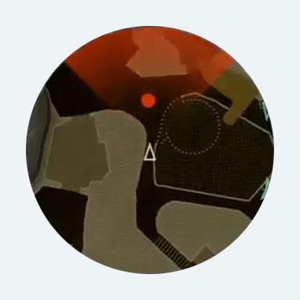
VISIBLE
Hints to the player of AI info / behaviour.
Minimap (...)

Slide 15
TO AVOID - METAGAMING
Using real life info to succeed
When the character is not aware of it
Example: re-enter level to loot

Slide 16
EXERCISE part 2:
Recover your part 1 friends and enemies and ...
TODO
Differentiate enemies from opponents
Which of the mentioned patterns will you use ?

Slide 17
THEMED ENEMY GROUPS

Slide 18
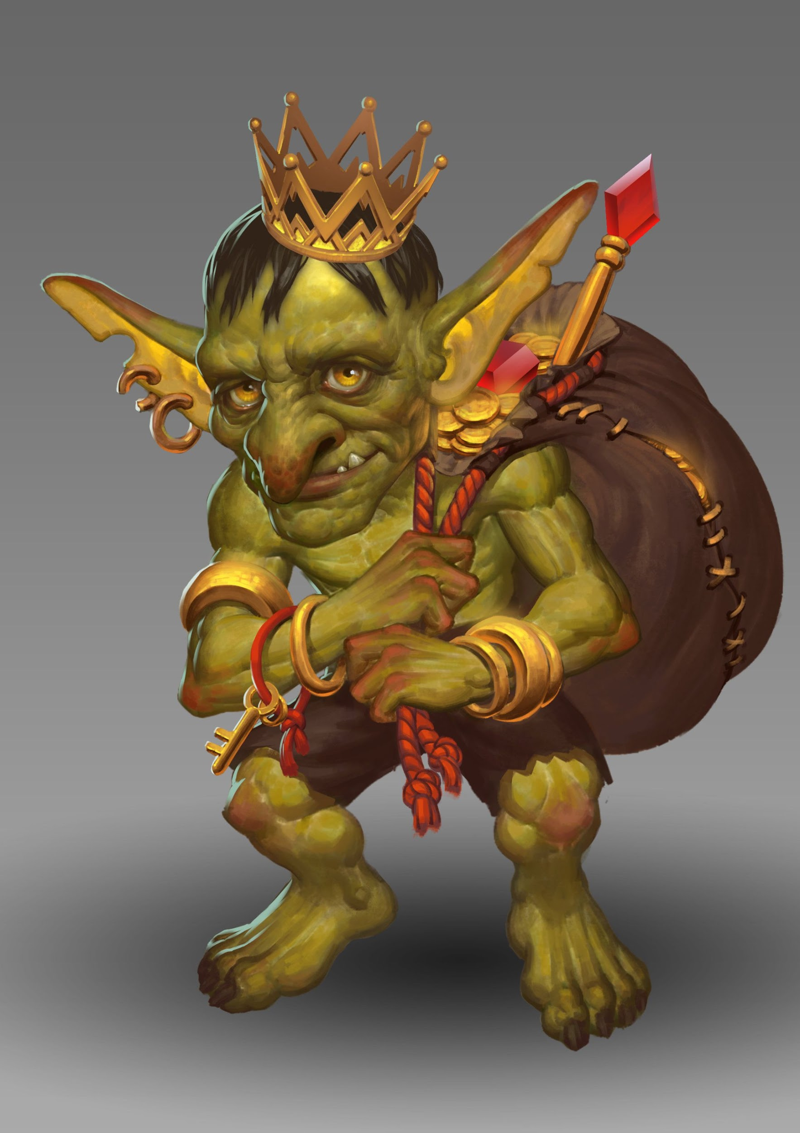
THEMATIC CONSISTENCY IN ENEMIES
Art, narrative… But most importantly:
behaviour
Example: loot depending on enemy type

Slide 19
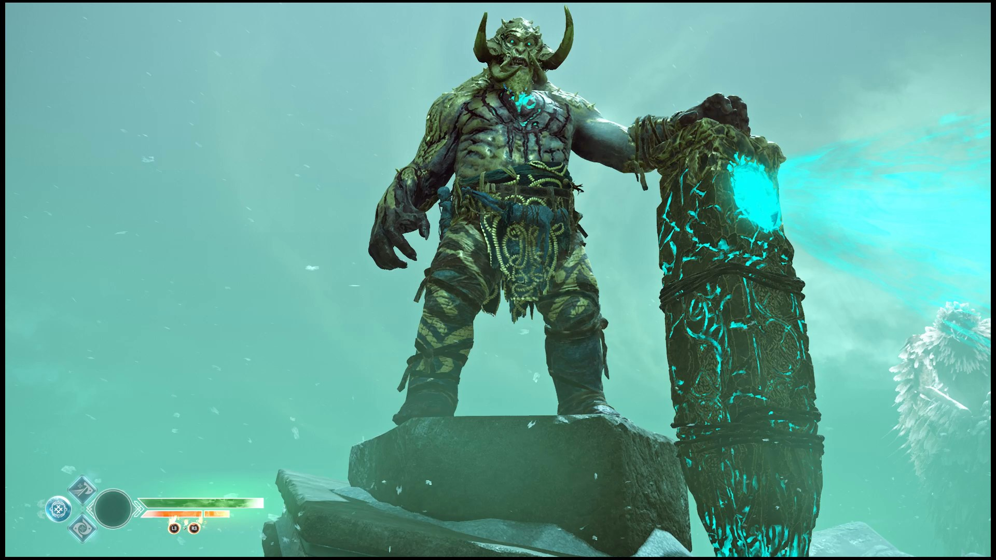
THEMED ENEMY GROUPS - OPTION 1
Recurrent enemy
Set of traits
Relation to lore
Miniboss level

Slide 20
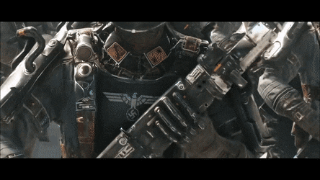
THEMED ENEMY GROUPS - OPTION 2
Group of weak enemies
Can have a leader
Example: patrol
these don’t seem so weak

Slide 21
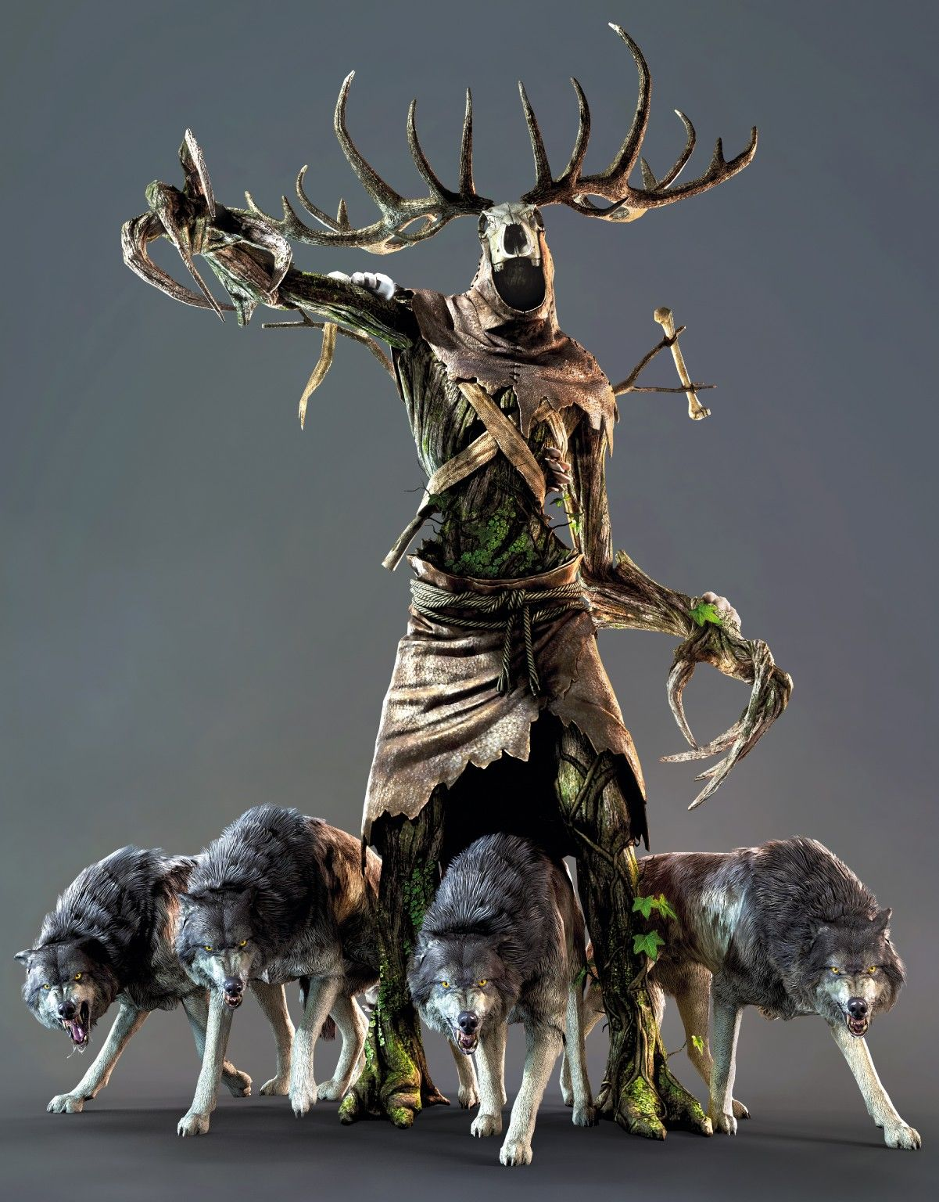
THEMED ENEMY GROUPS - OPTION 3: Encounter
Tank + weak enemies
2 types:
Tank attacker vs HP absorber

Slide 22
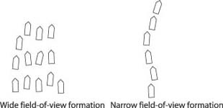
ENEMY FORMATIONS
Enemies aware of other enemies
Field of View
Radius around enemy

Slide 23
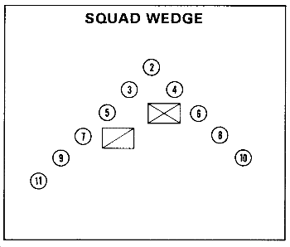
FORMATIONS - WEDGE
Enemy won’t shoot his friend
Useful for groups with leader

Slide 24
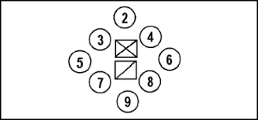
FORMATIONS - DIAMOND
4 directions covered
Hard to penetrate inside
Useful if they protect something

Slide 25
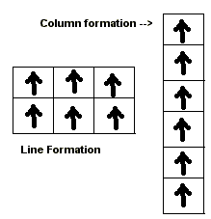
FORMATIONS - COLUMN & LINE
Very useful vs front / side attacks
But a bit weird

Slide 26

SPAWNING - The Problem: “Random Encounters”
Pokémon, Dragon Quest
Aleatory
Enemies: invisible or hard to avoid

Slide 27
SPAWNING - 3 Solutions
Large areas scripted for X enemy
Aleatory to a certain point
Infield Enemies: marked in map

Slide 28
COMMON ATTACKS
Waves: grupal
Long Range: keeps formation
Melee: Breaks formation and surrounds player
Hit & Run: individual

Slide 29
EXERCISE part 3:
Create a Themed Enemy Group for your game
Structure + Formation
How will you spawn enemies in your game?
TAKE INTO ACCOUNT

Slide 30
SCALABILITY

Slide 31
THE PROBLEM
State machines: good for a single NPC
Not enough for the whole NPC community

Slide 32
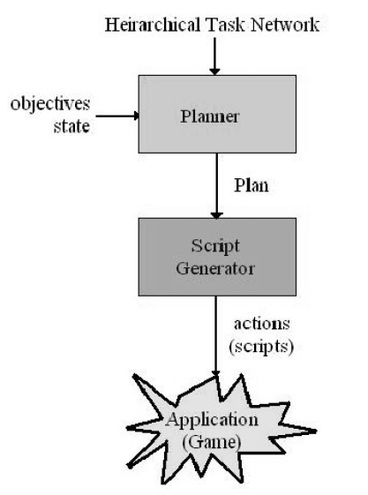
THE SOLUTION - Hierarchical Task Network (HTN)
World State
Sensors
Tasks: primitive vs compound
Conditions + operators
Domain
Planner: stack of tasks
Plan Runner

Slide 33
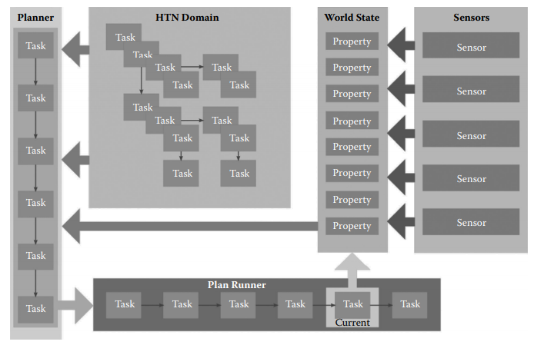
CORE LOOP

Slide 34
EXAMPLE PLAN CONDITIONS
Distance to player
Direction of player
Remaining HP
Extra for groups:
Group Strength

Slide 35
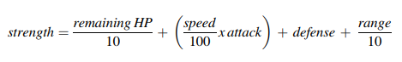
EXAMPLE PLAN CONDITIONS - GROUP STRENGTH

Slide 36
EXERCISE last part:
Discuss the HTN code structure in your game
draw.io for a XML
No need to finish. This can be homework
TAKE INTO ACCOUNT

Slide 37
THANKS
mdpdoctor7@hotmail.com

